Slide 1
Business Analytics
[ ]
Final
( prediction of university )
17102044 jeewon kim
18102085 byungchan lee
20102125 yujin pi

Slide 2



contents
+Problem Definition
+Purpose of analysis
Data sources
Future Features
Visualization

Slide 3
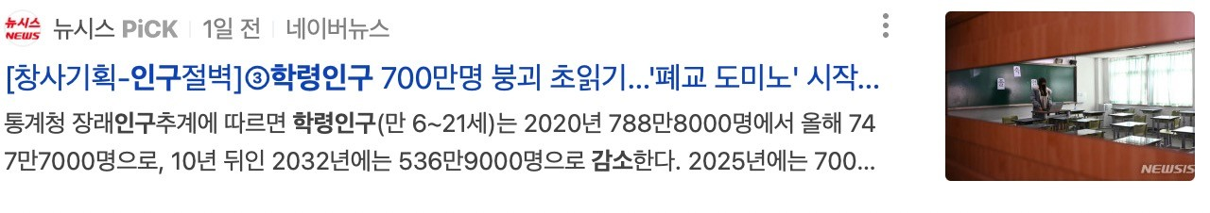
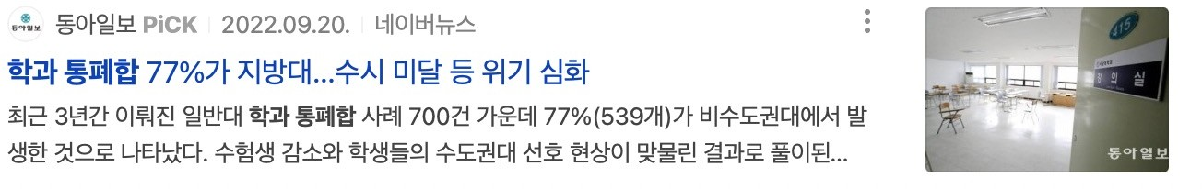

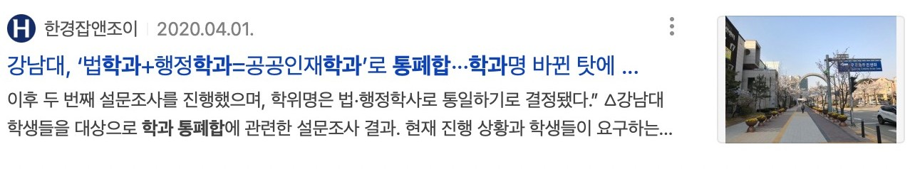
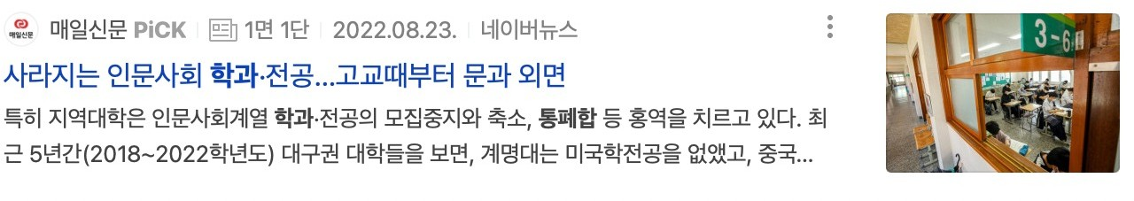

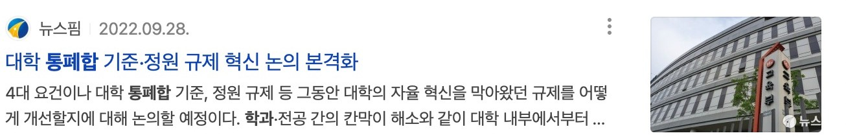

Problem definition
university departments

Slide 4
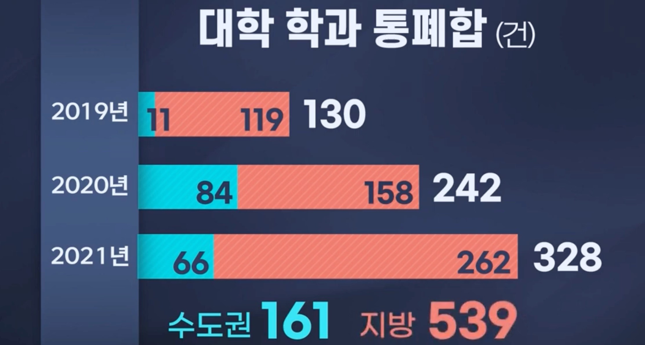
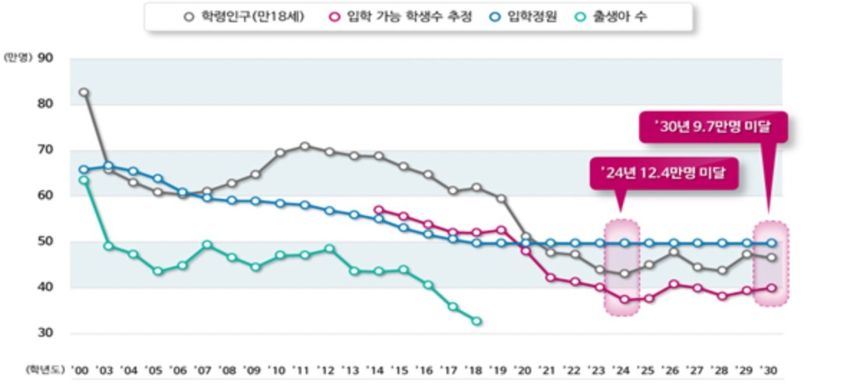
Problem definition
A trend of decreasing the school-age population and the number of students eligible for admissio n
Trends in integration and abolition of university departments
https://dgmbc.com/article/of6_NJK7wRCf8MK
As the number of students decreased,
the restructuring of universities was also being carried out intensively

Slide 5
Purpose of analysis
To predict departments or schools that might be integrated or abolished (by considering various factors)
1. For student
The predictions can be considered when selecting a university to go to.
2. For University
With the predictions, university can know th e position of the itself and prepare for it.

Slide 6
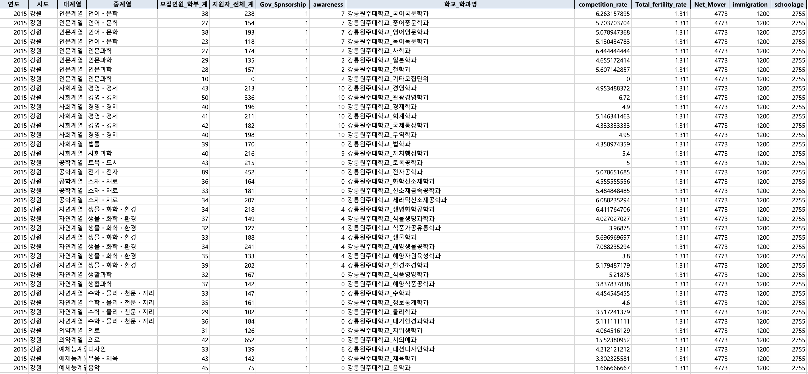
Part 1
Data
Column explanation
Year : Year information for each admission
Region : Region information for each school
Departmental Affiliation (major series) : A major classification of departmental affiliations
Departmental Affiliation (middle series) : A middle classification of departmental affiliations
The number to be admitted : Information on students admitted by departments
Candidate : The number of candidates
Government financial support
- 1 : Existence of government financial support
- 0 : No existence of government financial support

Slide 7
Part 1
Data
Column explanation
Awareness : Information on awareness of departmental affiliations to students by each year
School & Department : Information merged on school and each department
Competition rate : Information derived from dividing the number of applicants by the number to be admitted
Total fertility rate : Information on fertility rate by each region
Net mover : Information on net mover by each region
Immigration : Information on the number of immigration
Schoolage : Information on schoolage population by each year

Slide 8
Part 1
Data
Add ' 중계열 ' features in dataset

Slide 9
Part 1
Data
Add ' awareness ' features in dataset

Slide 10
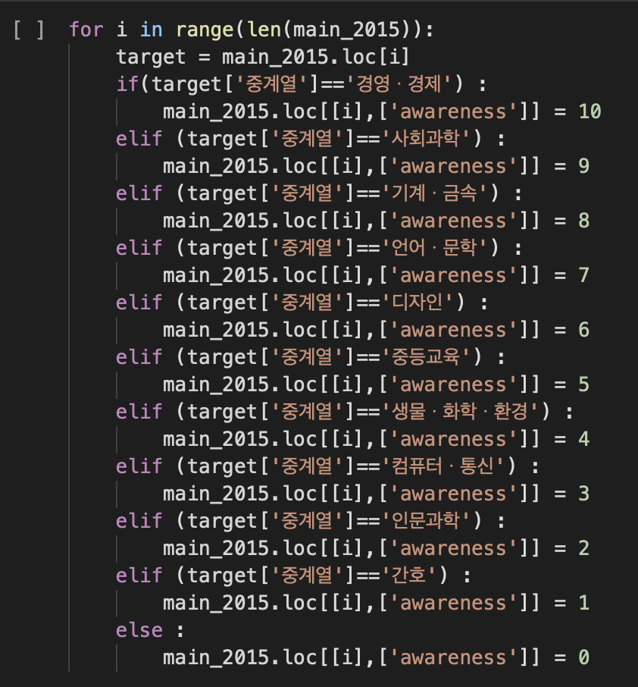
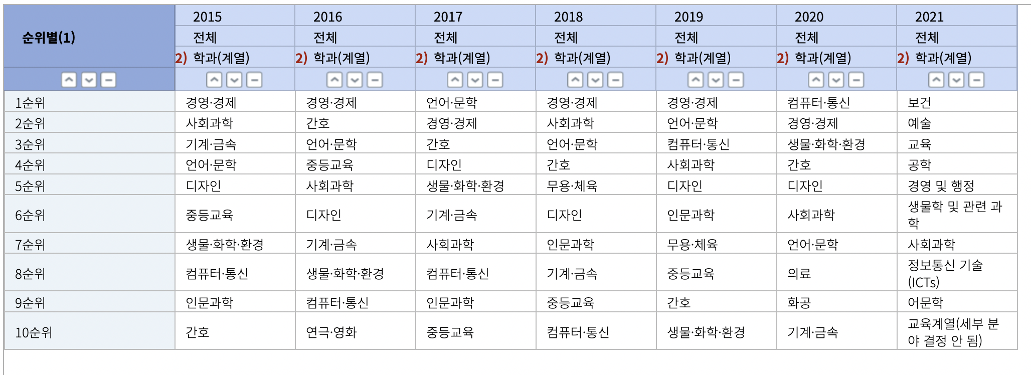
Part 1
Data
With department awareness data, set data 10 when the grade is 1

Slide 11
Part 1
Data
3717 * 7
= 26019 Instances
Only use intersection data(2015-2021) in ' School & Department '

Slide 12
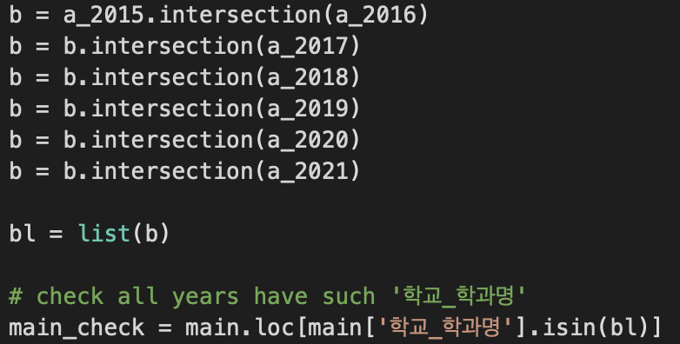
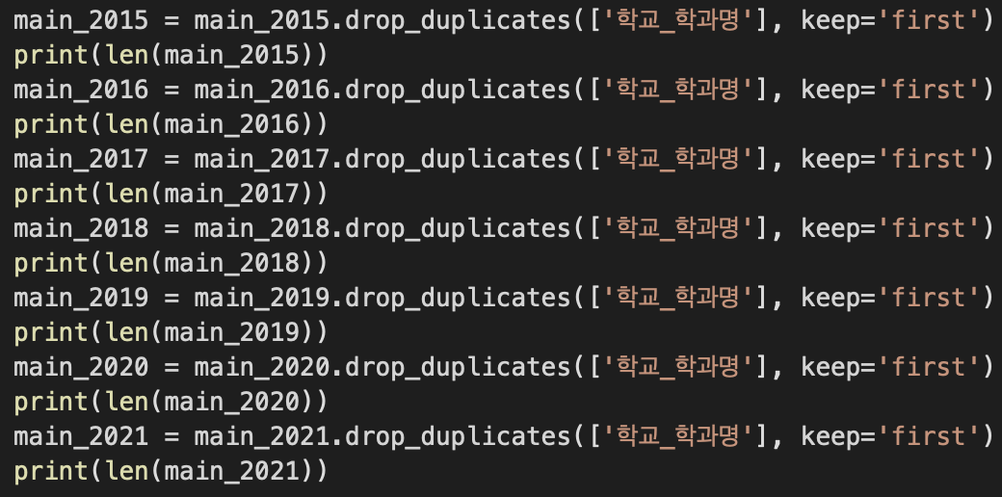
Part 1
Data
Use intersection in 2015-2021 with ' School & Department ' name
& Remove duplicated data

Slide 13
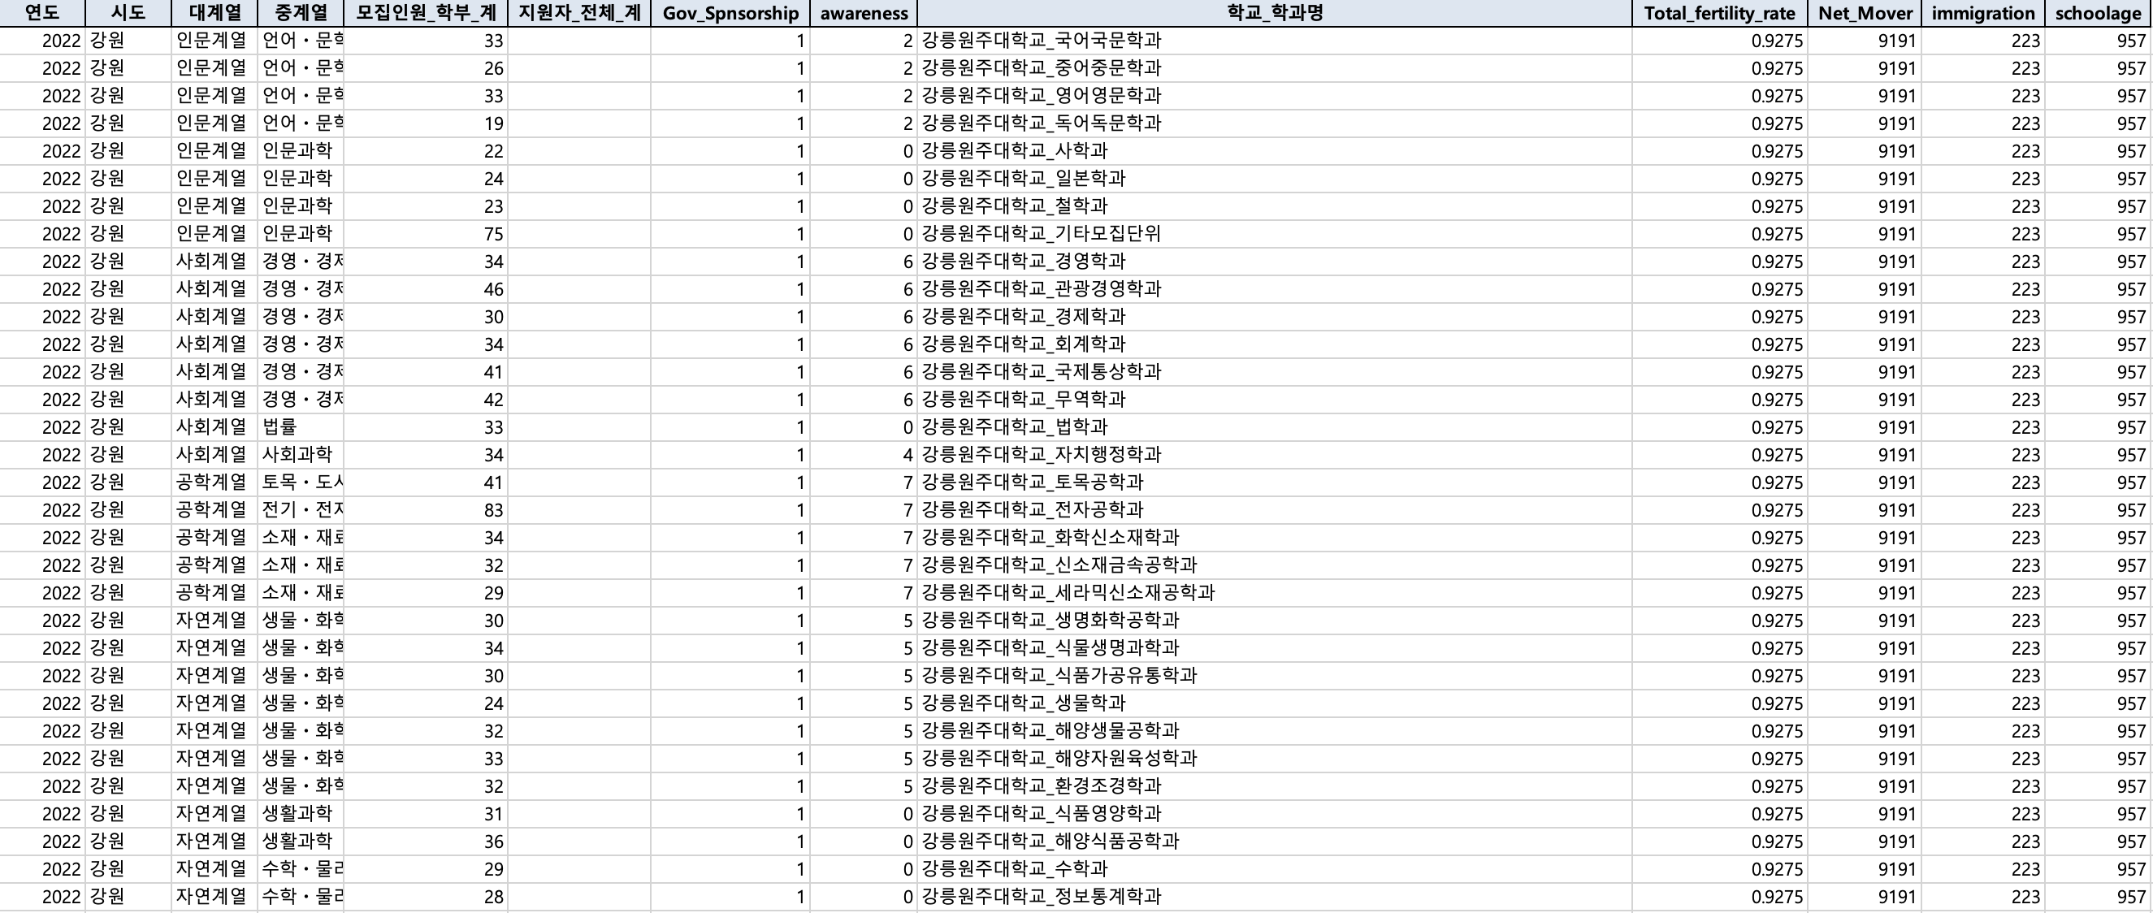
Part 2
Future Features
2022-2026 features
18,586 Instances

Slide 14
Part 2
Future Features
Target variable
The number to be admitted : Information on students admitted by departments
Candidate : The number of candidates
Government financial support
- 1 : Existence of government financial support
- 0 : No existence of government financial support
Awareness : Information on awareness of departmental affiliations to students
Total fertility rate : Information on fertility rate by each region
Net mover : Information on net mover by each region
Immigration : Information on the number of immigration
Schoolage : Information on schoolage population by each year

Slide 15

Part 2
Future Features
Schoolage :
Use dataset in STATISTICS KOREA

Slide 16
Part 2
Future Features
The number to be admitted / Government financial support / awareness :
Maintain the last data(2021)
Why?
To find the change of competition rate in same condition

Slide 17
Part 2
Future Features
Total fertility rate / Net mover / Immigration :
Calculate average of difference between 2 years
{((2019-2020) + (2020-2021))/2 }

Slide 18
Part 3
Model Training
Data Distribution
X_trainval, X_test, y_trainval, y_test for model training
X_train, X_valid, y_train, y_valid for deriving final result
from model training

Slide 19
Part 3
Model Training
Overall Pipeline Design
Numerical Variables
Categorical Variables
Preprocessor
Fit
Best Model

Slide 20
Part 3
Model Training
Numerical Variables
Columns
'모집인원_학부_계','Total_fertility_rate','Net_Mover','immigration','schoolage'
PolynomialFeatures with degree 2
+
StandardScaler
Pipeline(num_transformer)

Slide 21
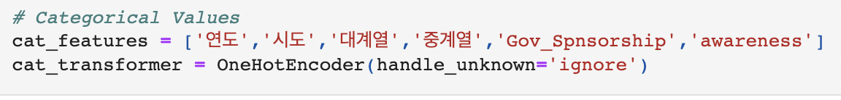
Part 3
Model Training
Categorical Variables
Columns
'연도','시도','대계열','중계열','Gov_Spnsorship','awareness'
OneHoeEncoder
Pipeline(cat_transformer)

Slide 22
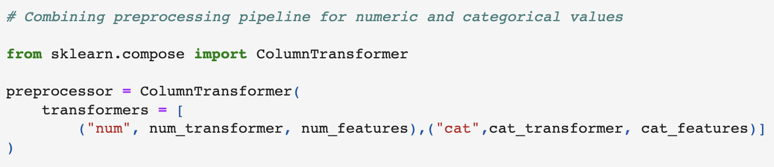
Part 3
Model Training
ColumnTransformer
Combining each categorical and numerical pipelines
num_transformer
cat_transformer
Numerical Variables
Categorical Variables
Preprocessor

Slide 23
Part 3
Model Training
Numerical Variables
Categorical Variables
Preprocessor
Fit
LinearRegression
LassoRegression
RidgeRegression
GradientBoostingRegressor
RandomForestRegressor
SupportVectorRegression
Kernel Ridge Regression
Model : Regression
Evaluation : R2 score
Kfold Gridsearch

Slide 24
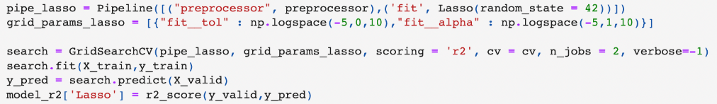
Part 3
Model Training
1. Linear Regression
R2 score
2. Lasso Regression
R2 score

Slide 25
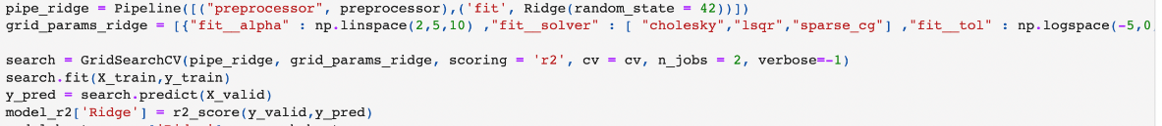
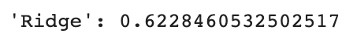
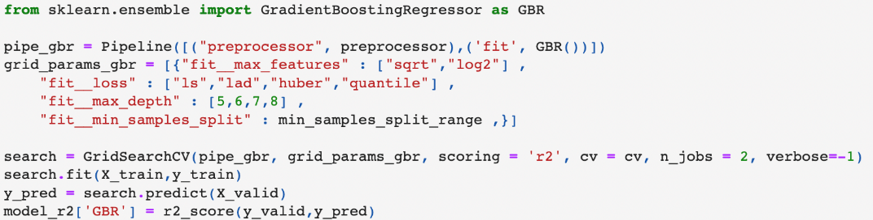
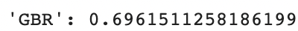
Part 3
Model Training
3. Ridge Regression
R2 score
4. GradientBoostingRegressor
R2 score

Slide 26
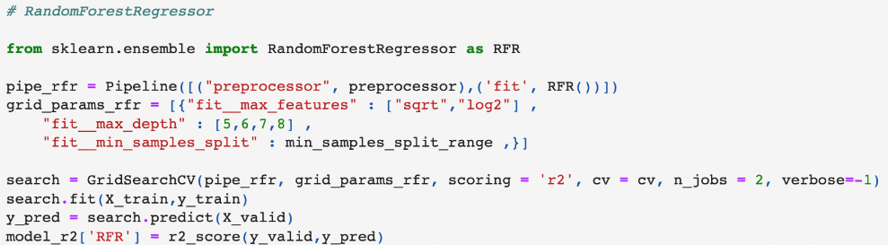
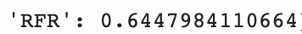
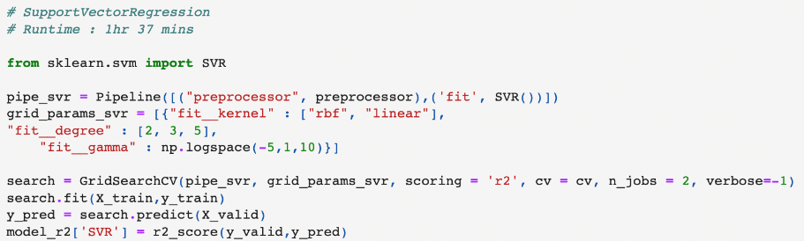
Part 3
Model Training
5. RandomForestRegressor
R2 score
6. SupportVectorRegressor
R2 score

Slide 27
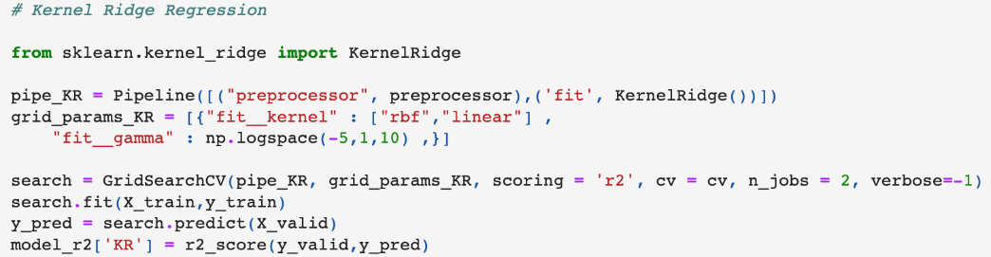
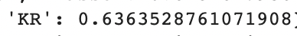
Part 3
Model Training
7. Kernel Ridge Regression
R2 score

Slide 28
Part 3
Model Training
Best model with hyperparameter
Numerical Variables
Categorical Variables
Preprocessor
Fit
Best Model : GradientBoostingRegressor
with hyperparameters

Slide 29
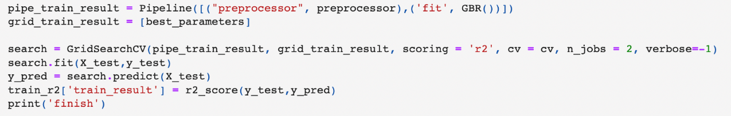
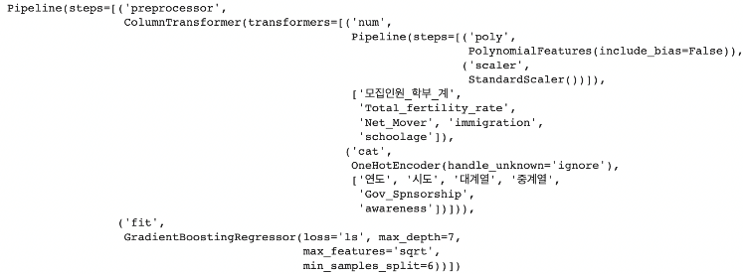
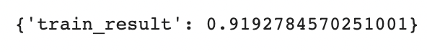
Part 3
Model Training
Validation with test dataset
Best Estimators
Final R2 result

Slide 30
Part 4
Predicting future
Future dataset + Best Model with best hyperparameters
Changing a type of target variable ‘지원자_전체_계’ into integer
Adding new column ‘competition_rate’
competition_rate = '지원자_전체_계’ / '모집인원_학부_계'

Slide 31
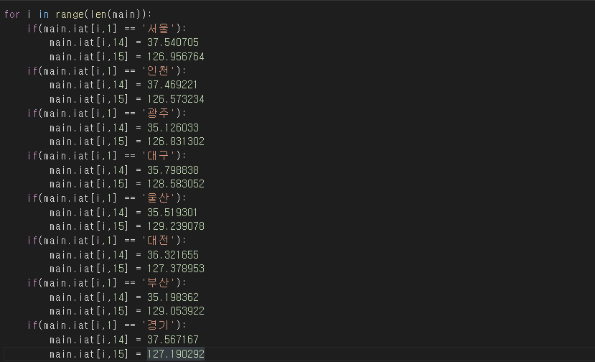
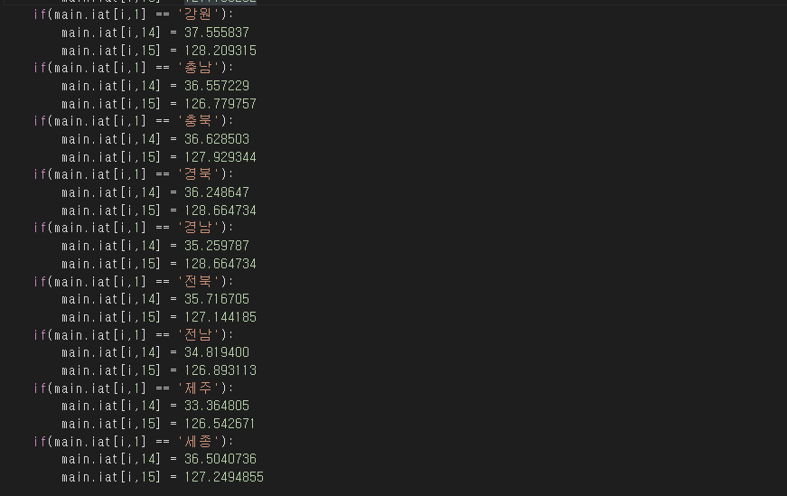
Part 5
Visualization
Add latitude and longitude data to represent in map chart of Spotfire.

Slide 32
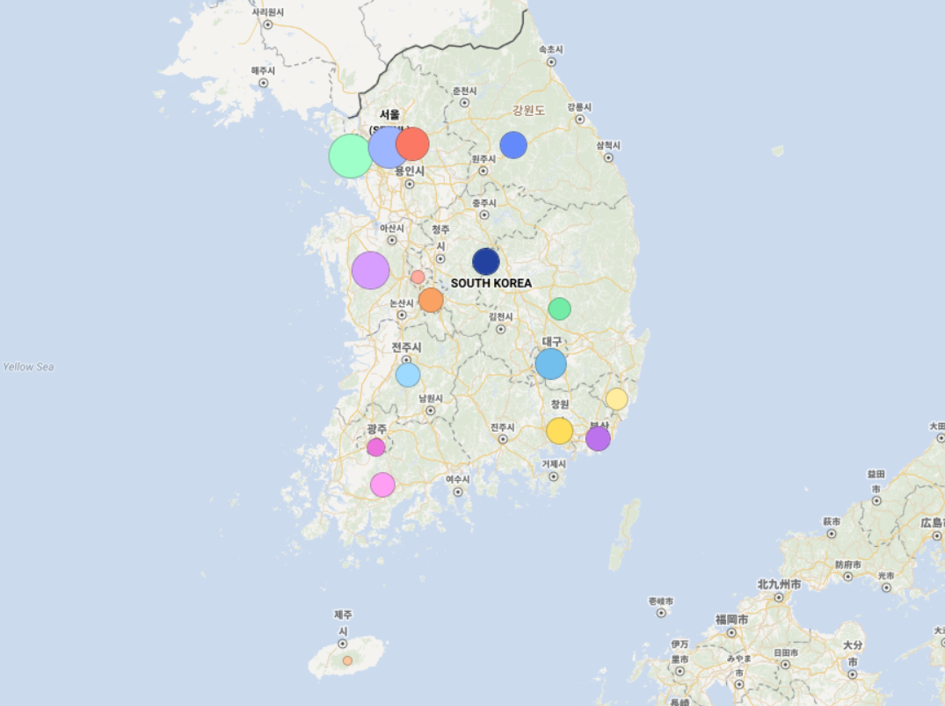
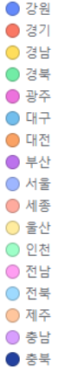
Part 5
Visualization
6.47
7.06
6.38
6.07
5.58
6.88
6.29
6.17
7.91
5.25
6.08
8.20
6.31
6.15
4.81
7.46
6.54
Average department competitiveness by region in 2026

Slide 33
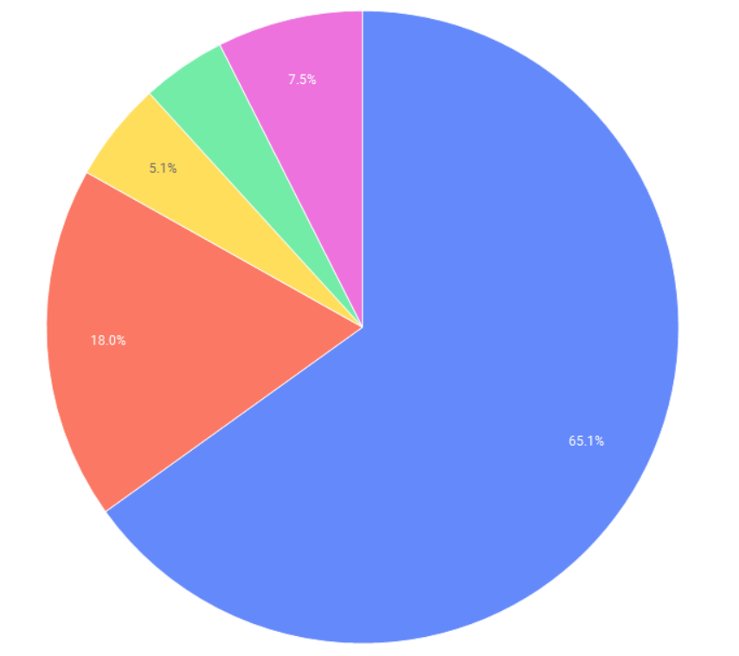
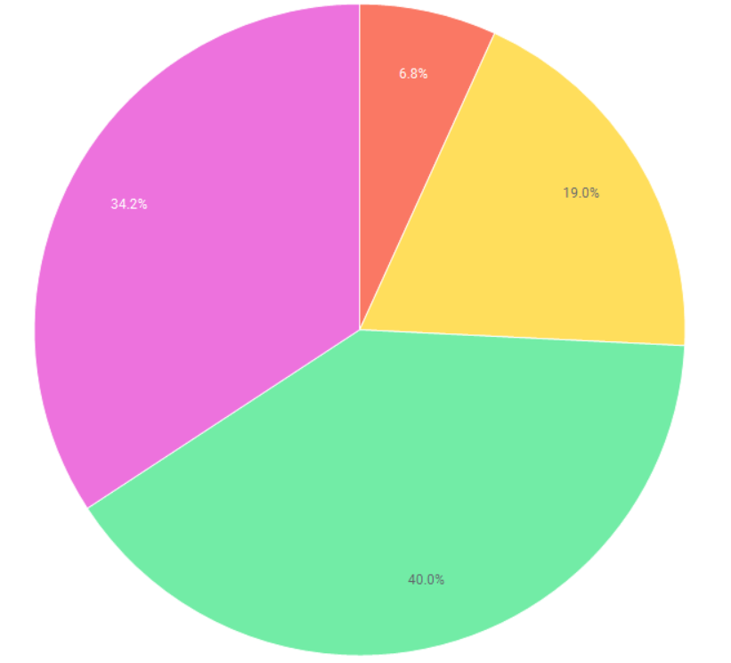
Part 5
Visualization
0~20%
20~40%
40~60%
60~80%
80~100%
제주
인천
Additional analysis of Jeju with the lowest average competitiveness
and Incheon with the highest average competitiveness

Slide 34
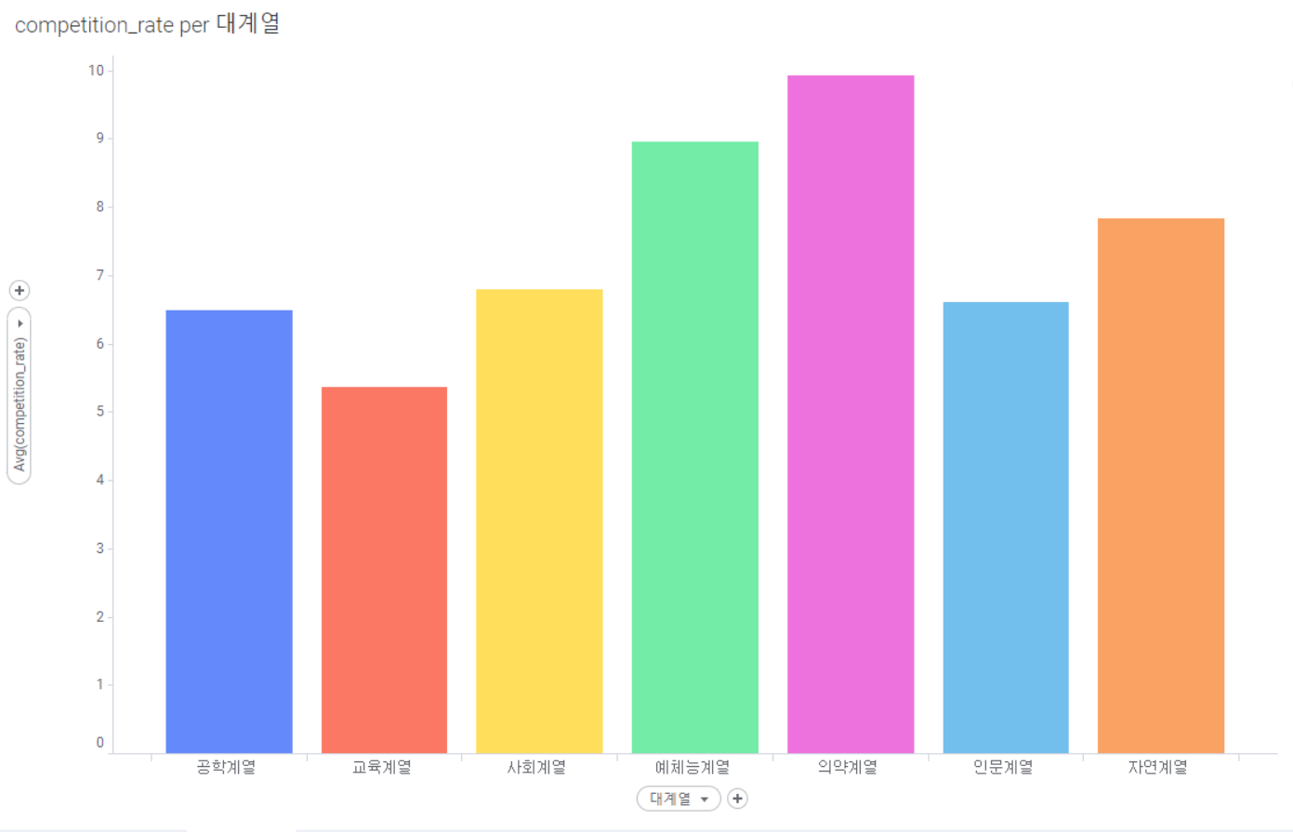
Part 5
Visualization
competitiveness ranking by major series in 2022

Slide 35
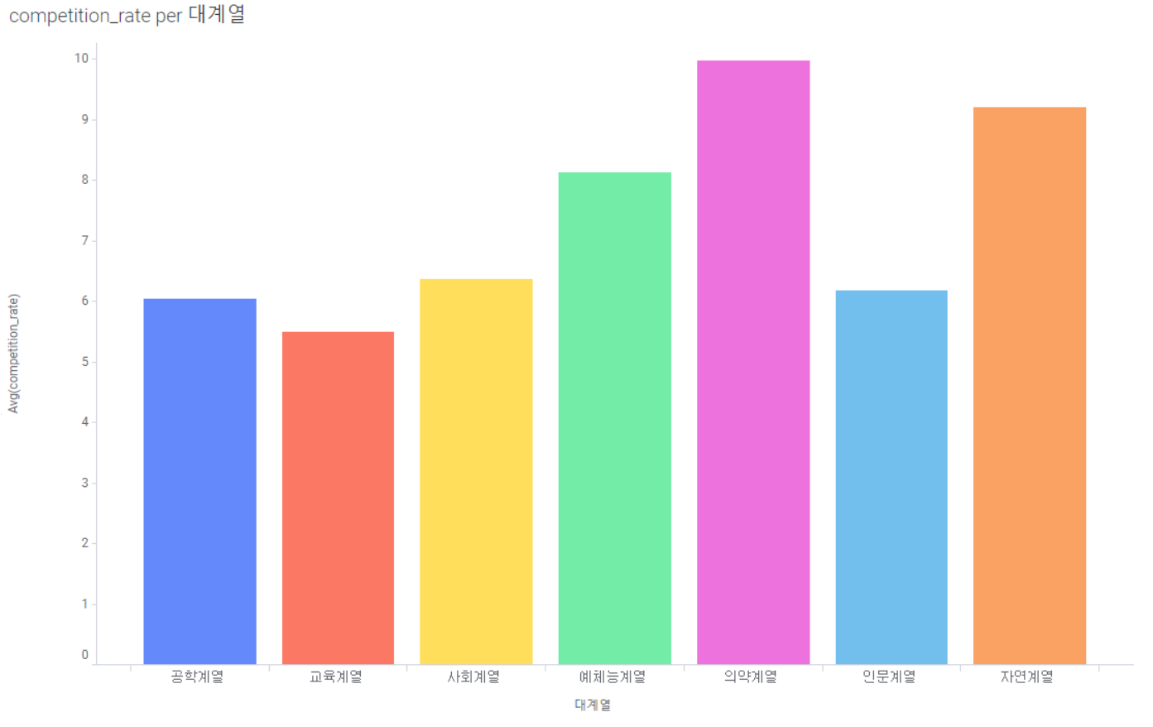
Part 5
Visualization
competitiveness ranking by major series in 2026

Slide 36
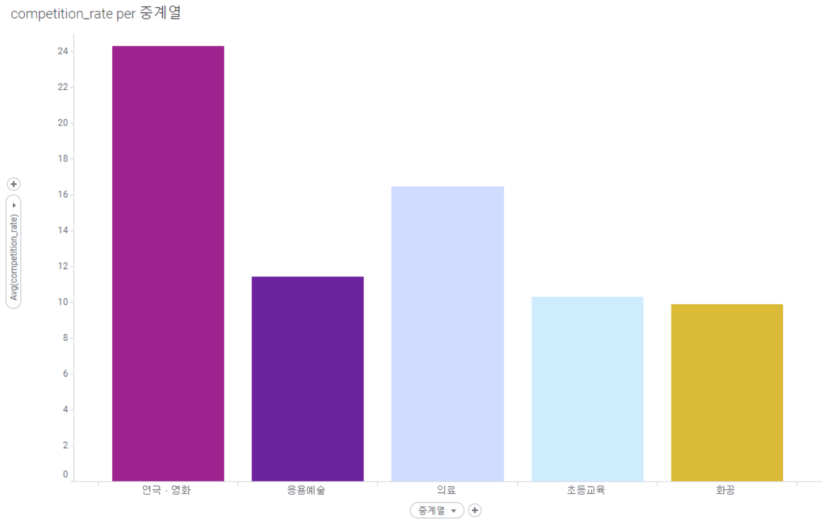
Part 5
Visualization
Average competitiveness top 5 by middle series in 2022.

Slide 37
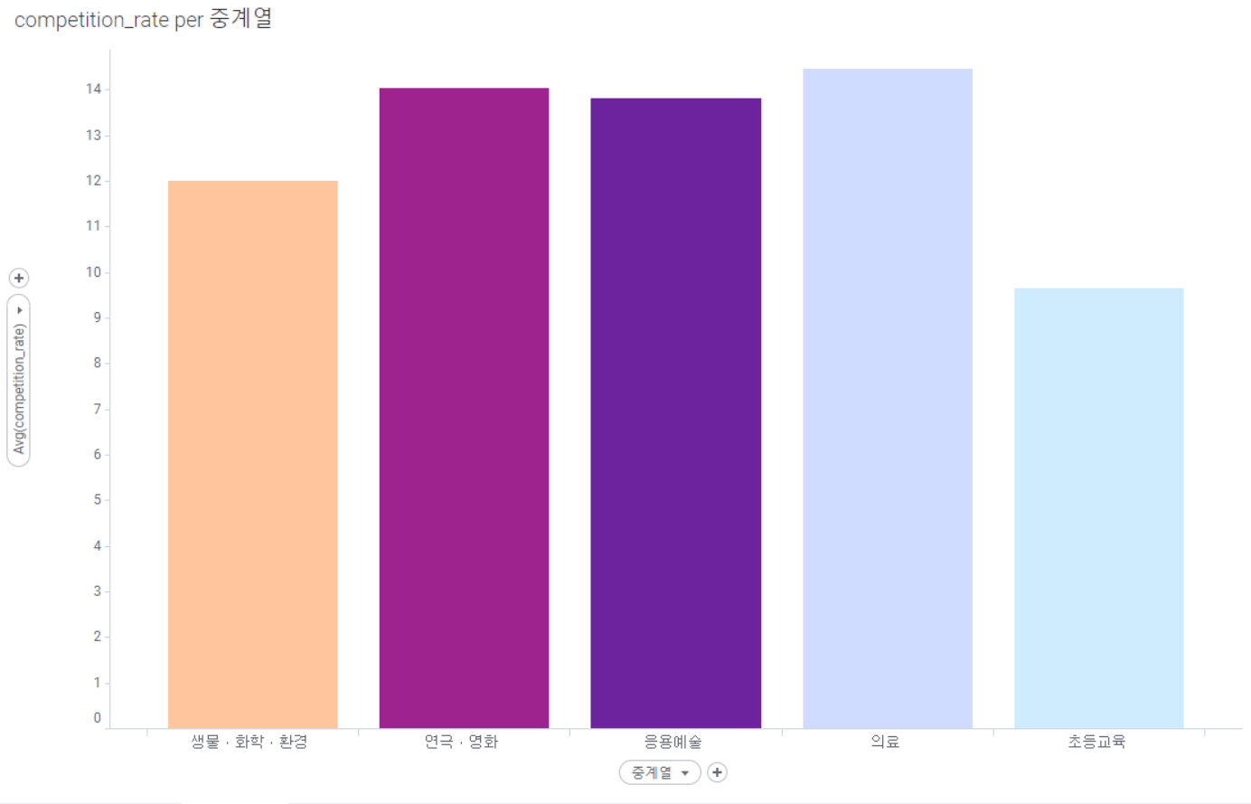
Part 5
Visualization
Average competitiveness top 5 by middle series in 2026

Slide 38
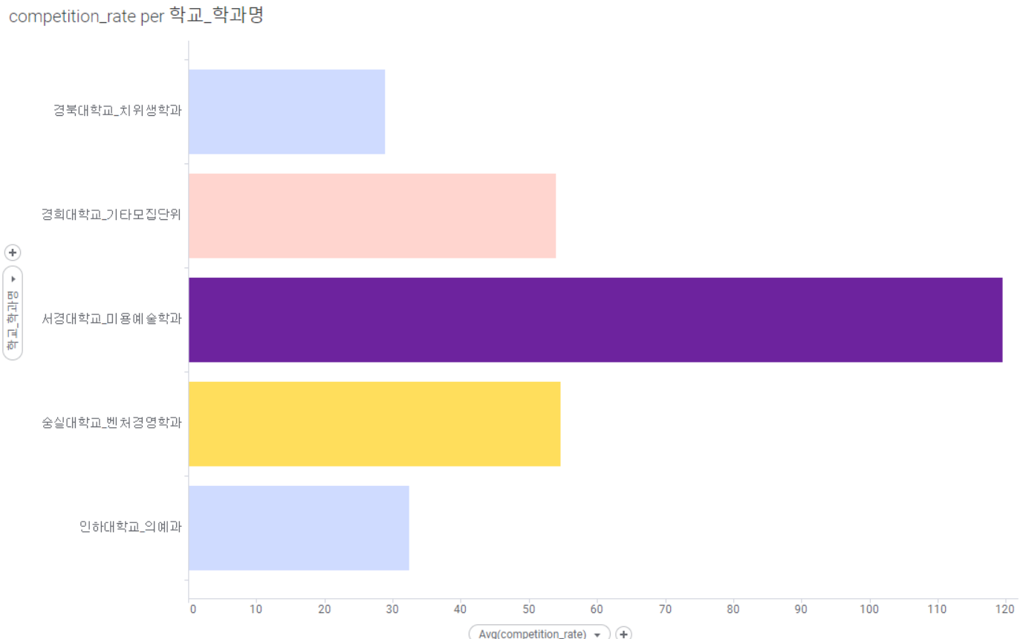
Part 5
Visualization
Average competitiveness top 5 department between 2022 and 2026.

Slide 39
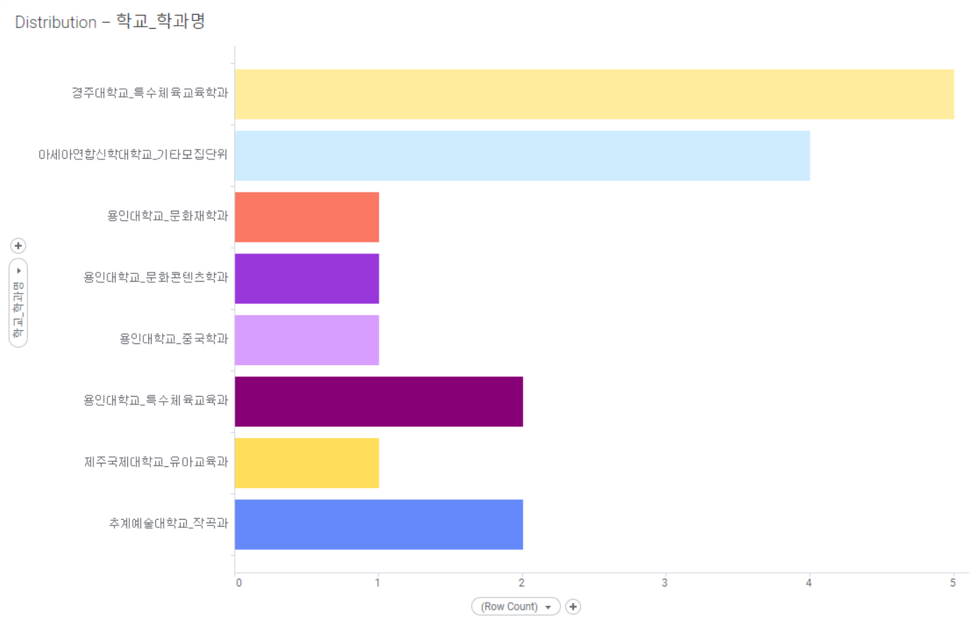
Part 5
Visualization
The list of departments with poor competency and the number of times
selected for each year

Slide 40
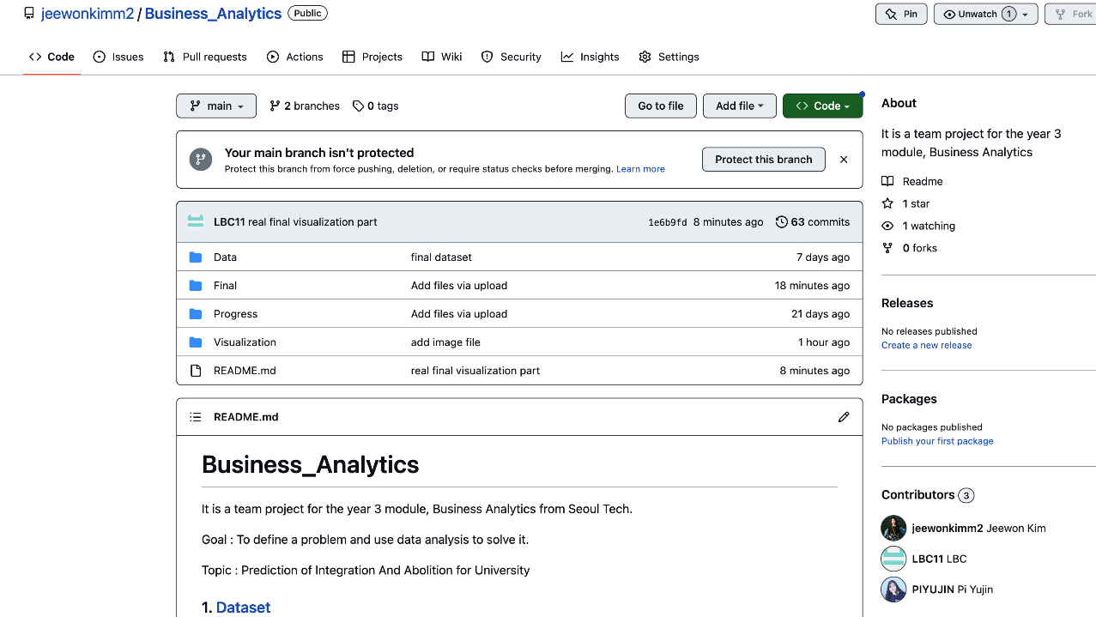
Github
Git Repository : https://github.com/jeewonkimm2/Business_Analytics

